Slide 1
State Research Institute of Aviation Systems (GosNIIAS), Moscow
E. Falkov
Taxonomy of aviation cyber threats and relevant protection methods: state-of-the-art and candidate solution paths

Slide 2
Subject Matter
Here we consider cyber security issues concerning cyber threats to critical aviation systems of Information and Communications Technologies (ICT) according to Doc 8973 Aviation Security Manual Chapter 18 and Doc 9985 Air Traffic Management Security Manual Part 1 Chapter 5 and Appendixes B and C , that is:
ICT cyber security, associated with the interaction of aircraft with ATC system and airspace users in case of possible unintentional errors and deliberate cyber attacks on ICT.

Slide 3
Cyber Security problems – how they appeared?
It is after-effects of automation, use of computers
Cyber security of a “corporative” aircraft computer and computer network after closing the aircraft door – use of McAfee, Norton, Kaspersky, etc. programs and restrictions in physical access to aircraft network are not considered here
Subject matter are cyber security issues caused by data and voice regular interaction of pilots with ATC and airspace users with follow-on possible unintentional errors as well as intentional cyber attacks of violators

Slide 4
Often we wait and do nothing. Cyber Impacts: “Black Swan” – a theory studying difficult to forecast rare events which nevertheless may have critical sometimes disastrous effects
According to Taleb, “Black Swan” has got
following criteria:
1. The event is unexpected (for experts as well).
2. The event causes significant, sometimes devastating impacts.
3. After the event took place, in retrospective, the event may be rationalized, as if it were expected.
Examples of “Black Swan” are Internet development and implementation, First World War, 11 September Attack.
According to Taleb, mankind is unable to predict successfully its future, and self-confidence in knowledge overrides the knowledge itself.
Belief in successful prediction of future events on the basis of the analysis of those that have already happened or not happened.

Slide 5
Study of Cyber Attacks with reference to ADS-B in NextGen (USA) and SESAR (Europe). ADS-B here is only the example but the brightest one.
Key aspect of the plan of NextGen and SESAR modernization is the Automatic Dependent Surveillance – Broadcast (ADS-B) system for Air Traffic Management (ATM).
Earlier new technologies were usually oriented on functional abilities and not on protection. ADS-B provides for permanent broadcasting of location, ID, velocity and other information about aircraft via unencrypted datalinks.
Weak points in ADS-B protection are mainly inspired by cross purposes of open sharing of information and necessity of protection.
1090ES ADS-B lacks mechanisms protecting confidentiality, integrity and availability of air-to-ground and air-to-air data. As a result, a motivated intruder may throw in false data or prevent duly display of true data. These actions may damage the air traffic system.

Slide 6
Taxonomy of ADS-B attacks
Taxonomy of ADS-B attacks takes into account:
1. Methods of attacks able to use weak points in ADS-B protection system
2. Element(s) including purpose of attack, and
3. Difficulties of the attack preparation and execution.
Methods of attacks :
Interception of ADS-B transmissions,
Jamming of transmissions in order to prevent the reception of true ADS-B messages, and
3. Throw in false ADS-B messages into datalinks.
Main objects of attacks:
Ground station
Aircraft

Slide 7
Difficulty level of attacks
Difficulty level of attack depends on skills necessary to execute an attack.
Low level of difficulty means that the attack may be executed by available avionics and software with minimum adjustment or without any, and with minimum knowledge about the airspace system (for example, having bought COTS avionics or electronics via Internet, and having downloaded software from Internet). Typical example is equipment for the participation in flightradar24.com
Middle difficulty level of attack includes a modification of functional capabilities in order to reach desired effect; such an attack assumes ordinary knowledge about operations in the airspace system.
Attack with high difficulty is complicated and requires complex means and functional capabilities, as well as extensive knowledge of the infrastructure and operations of the airspace system.

Slide 8
Examples of ADS-B attacks
Attack | Purpose of attack | Method of attack | Difficulty level
Aircraft search and identification | Aircraft | Interception of ADS-B Out signals | Low
Failure due to ground station jamming | Ground station | Jamming | Low
False target throw in on the ground station | Ground station | Ghost message throw in | Middle-to-high
Failure due to aircraft jamming | Aircraft | Jamming | Middle
False target throw in on aircraft | Aircraft | Ghost message throw in | Middle-to-high
Throw in of several false targets on the ground station | Ground station | Several ghost messages throw in | Middle-to-high

Slide 9
Evolution of views to ADS-B
Use of unencrypted datalinks for ADS-B stood on belief of low probability of malicious application. There is no mechanism to protect confidentiality, integrity and availability of air-ground and air-air data within ADS-B.
Initially for a long time they believe that arising problems of protection cause no real threats to ADS-B, since efforts required to execute critical attacks were considered too complicated and expensive.
Such a view on ADS-B protection has been dramatically changed recently after researches and statements of hackers at Black Hat and DEFCON conferences announcing the possibility of successful attacks on ATC using quite inexpensive soft-designed radio systems.
Since that time ADS-B cyber protection issues took leading positions in FAA and ICAO agendas.

Slide 10
Variety of Cyber Attacks
An attack scenario consist of intruders’ intentions to forge the true air situation by the throw in false messages about positions of non-existing aircraft.
Such a throw in is the softest method of attack. It makes no difficulties to establish signals when an arbitrary large set of various trajectories will comply with one and the same selected ID of a real aircraft.
An attacker might be fixed, mobile and is capable to move on the ground or in the air.

Slide 11
Efforts and results must be balanced
It is important to investigate both technical and non-technical approaches.
For instance, ADS-B is vulnerable to attacks when messages are being transmitted mainly due to absence of message encryption. Spoofing (false messages insertion) might be excluded with the help of authenticity schemes. But there was anxiety that distribution and management of keys would overload aviation. The issue demands to be studied.
In any case it is important to develop complex models that include technologies, strategy and regulation which all together would establish (like following ARP 4754A) the right balance between protection and functional capabilities.

Slide 12
Not only technics but also psychology factors
When pilots or/and ATC staff are not able to get accurate and well-timing information the loss of situation awareness occurs.
For an intruder it might be enough merely to decrease the trust to the system. The carefully developed attack might initiate multiple consequences having transformed a pilot or a controller uncertain in getting trustworthy information.
The most dangerous attacks lead to the loss of control. In this case the intruder imposes on ATC staff and pilots the execution of unplanned and invalid actions. For instance, the insertion of false targets may force the pilot to “correct” the route with heavy consequences.

Slide 13
GosNIIAS’ spoofing tests: the scheme
June 2016, St.-Petersburg
Laptop to control 1090 ES
signal simulator
ATC Laptop to display air situation data
SMBV100A vector generator
Certified receiver
of 1090 ES signals
Antenna or Feeder
HF signals adder
HF signals adder
HF signal splitter
1090ES signal simulator
Adjustable attenuator
Intruder’s Laptop to display air situation data
Non-ATC receiver of 1090ES signals

Slide 15
Conclusions on ADS-B 1090 ES from the point of view of cybersecurity
Air-ground surveillance.
In accordance with ICAO documents Doc 9924, Doc 9994, ASWG TSG WP 02-27, SP-ASWG3-WP24 to use ADS-B data it is necessary to mandatorily verify this data concerning aircraft position with the help of SSR or WAM data. Thus use of ADS-B 1090 ES data from economical point of view is becoming substantially non-efficient because SSR or WAM are all-sufficient and they determine the aircraft position within ATC system independently without any ADS-B but much more expensive in comparison with such ADS-B which does not need any support by SSR or WAM data.
2. Air-air surveillance.
Verification of such a data is possible only with the help of TCAS data, i.e. on small distances and with radical restrictions on aircraft nomenclature. But also in this case after verification by TCAS data ADS-B 1090 ES is becoming useless.

Slide 16
October 2016, ICAO Surveillance Panel, Amendments to Doc 9924 Aeronautical Surveillance Manual, Chapter 3
“a) Anti-spoofing
Some surveillance systems such as SSR & ADS-B are vulnerable to spoofing. ATM automation systems can reduce this vulnerability … overlapping surveillance coverage from other surveillance sources such as radar and multilateration, where available.
One of the measures to deal with excessive spoofing is to disconnect the affected ADS-B ground station or radar and treat the event as identical to ground equipment failure”.
Comment
It is acknowledged to resist to spoofing it is necessary to support ADS-B data by SSR or WAM data. Possible alternative is switching of ADS-B ground station off, i.e. refusal to deliver ATC services. It reminds the radical remedy from dandruff is guillotine.

Slide 17
ADS-B is an efficient and wanted application
ADS-B based on1090 ES is evidently not so good from the cybersecurity point of view.
1090 ES is not the alone data link for ADS-B (UAT and VDL-4 with full set of standards).
Comparison of 1090 ES and VDL-4

Slide 18
ADS-B (surveillance tasks)
Functions | 1090 ES | VDL-4
Air-ground surveillance:
Under SSR or WAM support, but it is difficult to name it as ADS-B | Is provided | Is provided, support is not needed
Without SSR or WAM support | Is not provided | Is provided
Air-air surveillance:
Commercial aviation:
Under TCAS support on small distances; is it really ADS-B? | Is provided | Is provided, support is not needed
Beyond TCAS support | Is not provided | Is provided
GA, helicopters, RPAS | Is not provided | Is provided

Slide 19
Not only surveillance but also other aeronautical service functions
Functions | 1090 ES/additional datalinks | VDL-4
ADS-B Out | Yes; saturation under heavy traffic, no guarantee | Yes
ADS-B In | In principal Yes, but in NextGen and SESAR is not included | Yes
TIS-B | In principal Yes, but see ADS-B In | Yes
Search and Rescue | See ADS-B In | Yes, approved by Russian CAA
Point-to-point comms: CPDLC, ADS-C, AOC | VDL-2, full confusion in Europe, implementation plans are remarkably drifted | Yes
DGNSS: integrity + differential corrections | VDB | Yes
A-SMGCS | AeroMax | Yes
FIS-B | Under FAA concept in principal No | Yes
All data exchange through datalinks must be cyberprotected

Slide 20
Self-organizing Airborne Network (SOAN), providing full cybersecurity and additional ATS functions
Subject | 1090 ES | VDL-4
Capability to create and function SOAN with full provision of cybersecurity and numerous set of air navigation services | Very problematic, no time stamping, no references, the forecast is negative | Approved by 12-th ANC (Recommendation 1/10) and 38-th Assembly, SARPs drafts are being considered in ICAO RPASP

Slide 21
“MH370 flight consideration if mandatory non-stop ADS-B and self-organized airborne network were used”
Why mandatory ADS-B and self-organized airborne network is so important?
SP-ASWG3-IP/05 11/04/16

Slide 22
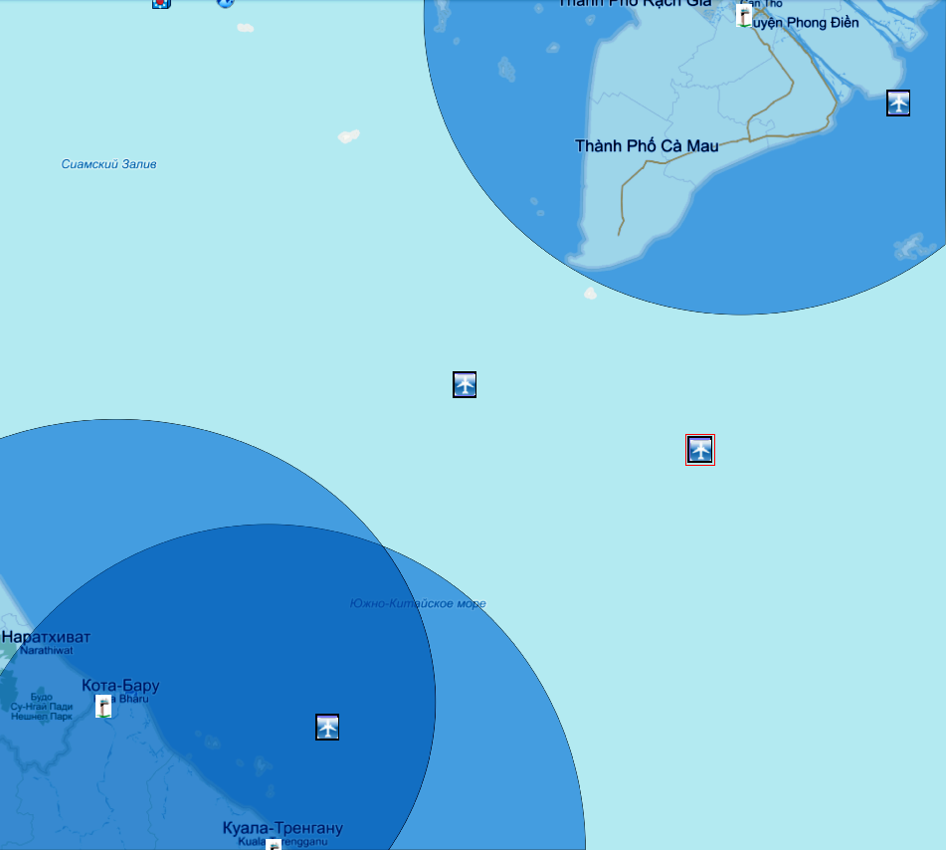
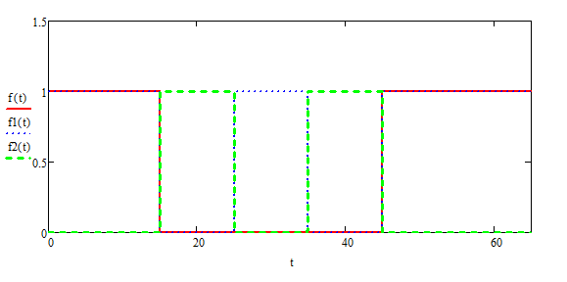
Real MAS318 (MH370 analog) flight 23.03.14, 17:15 UTC, tracking as it is
Tho
TGW2907
MAS6116
CES539
Bharu
MAS318
Terengganu
No
Surveillance under SSR & ADS-B, tracking in ATC
Surveillance under SSR & ADS-B, tracking in ATC
No surveillance, no tracking
17:15
17:35
17:55
18:15
UTC

Slide 23
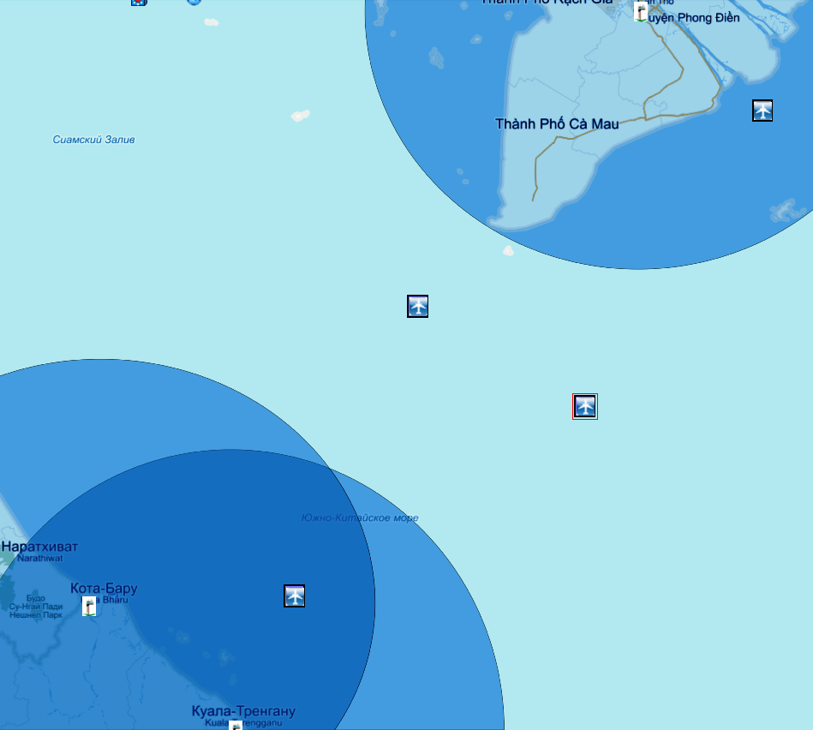
Real MAS318 (MH370 analog) flight 23.03.14, 17:20 UTC, tracking as it is
Tho
TGW2907
MAS6116
CES539
Bharu
MAS318
Terengganu
No
Surveillance under SSR & ADS-B, tracking in ATC
Surveillance under SSR & ADS-B, tracking in ATC
No surveillance, no tracking
17:15
17:35
17:55
18:15
UTC

Slide 24
Real MAS318 (MH370 analog) flight 23.03.14, 17:25 UTC, tracking as it is
Tho
TGW2907
MAS6116
CES539
MAS318
Bharu
Terengganu
No
Surveillance under SSR & ADS-B, tracking in ATC
Surveillance under SSR & ADS-B, tracking in ATC
No surveillance, no tracking
17:15
17:35
17:55
18:15
UTC

Slide 25
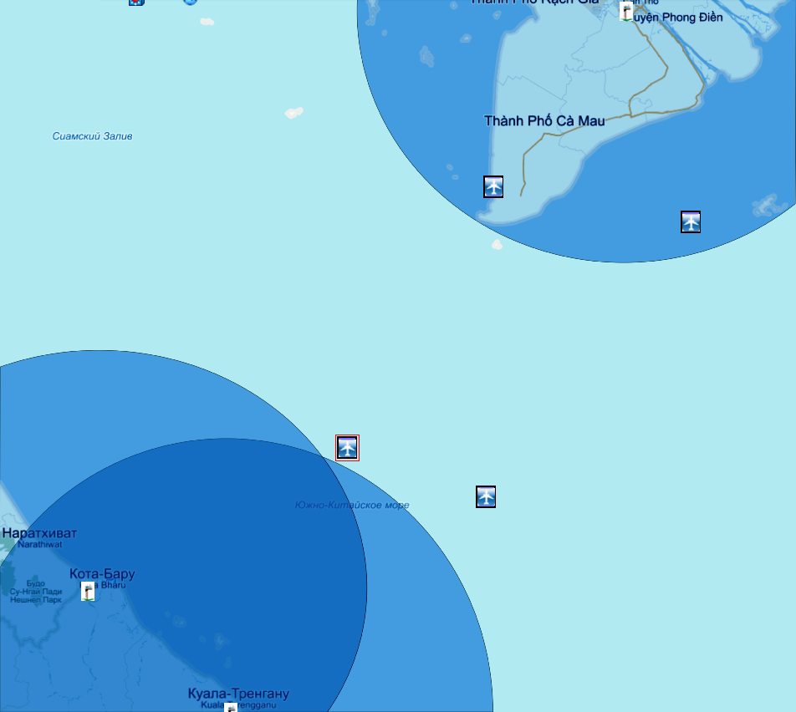
Real MAS318 (MH370 analog) flight 23.03.14, 17:30 UTC, tracking as it is
Tho
TGW2907
MAS6116
MAS318
CES539
Bharu
Terengganu
No
Surveillance under SSR & ADS-B, tracking in ATC
Surveillance under SSR & ADS-B, tracking in ATC
No surveillance, no tracking
17:15
17:35
17:55
18:15
UTC

Slide 26
Real MAS318 (MH370 analog) flight 23.03.14, 17:35 UTC, tracking as it is
Tho
MAS6116
TGW2907
MAS318
CES539
Bharu
Terengganu
No
Surveillance under SSR & ADS-B, tracking in ATC
Surveillance under SSR & ADS-B, tracking in ATC
No surveillance, no tracking
17:15
17:35
17:55
18:15
UTC

Slide 27
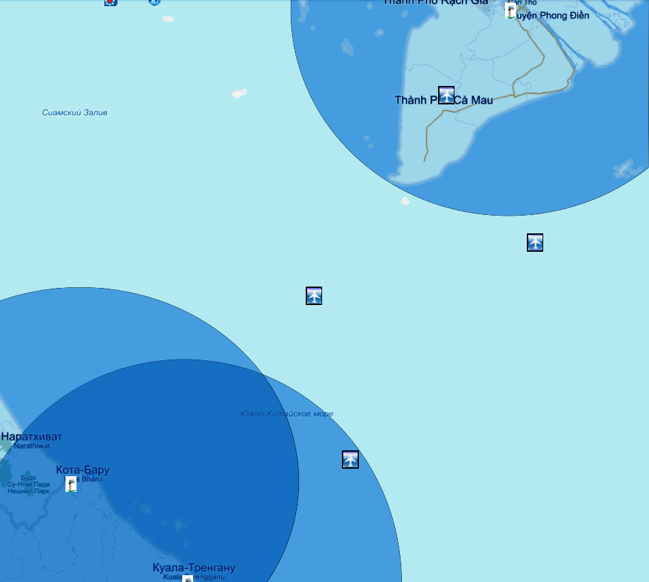
Real MAS318 (MH370 analog) flight 23.03.14, 17:40 UTC, tracking as it is
Tho
MAS6116
TGW2907
MAS318
CES539
Bharu
Terengganu
No
Surveillance under SSR & ADS-B, tracking in ATC
Surveillance under SSR & ADS-B, tracking in ATC
No surveillance, no tracking
17:15
17:35
17:55
18:15
UTC

Slide 28
Real MAS318 (MH370 analog) flight 23.03.14, 17:45 UTC, tracking as it is
Tho
MAS6116
MAS318
TGW2907
CES539
Bharu
Terengganu
No
Surveillance under SSR & ADS-B, tracking in ATC
Surveillance under SSR & ADS-B, tracking in ATC
No surveillance, no tracking
17:15
17:35
17:55
18:15
UTC

Slide 29
Real MAS318 (MH370 analog) flight 23.03.14, 17:50 UTC, tracking as it is
Tho
MAS6116
MAS318
TGW2907
Bharu
CES539
Terengganu
No
Surveillance under SSR & ADS-B, tracking in ATC
Surveillance under SSR & ADS-B, tracking in ATC
No surveillance, no tracking
17:15
17:35
17:55
18:15
UTC

Slide 30
Real MAS318 (MH370 analog) flight 23.03.14, 17:55 UTC, tracking as it is
MAS6116
Tho
MAS318
TGW2907
Bharu
CES539
Terengganu
No
Surveillance under SSR & ADS-B, tracking in ATC
Surveillance under SSR & ADS-B, tracking in ATC
No surveillance, no tracking
17:15
17:35
17:55
18:15
UTC

Slide 31
Real MAS318 (MH370 analog) flight 23.03.14, 18:00 UTC, tracking as it is
Tho
TGW2657
MAS318
TGW2907
Bharu
Terengganu
No
Surveillance under SSR & ADS-B, tracking in ATC
Surveillance under SSR & ADS-B, tracking in ATC
No surveillance, no tracking
17:15
17:35
17:55
18:15
UTC

Slide 32
Real MAS318 (MH370 analog) flight 23.03.14, 18:05 UTC, tracking as it is
Tho
MAS318
TGW2657
TGW2907
Bharu
Terengganu
No
Surveillance under SSR & ADS-B, tracking in ATC
Surveillance under SSR & ADS-B, tracking in ATC
No surveillance, no tracking
17:15
17:35
17:55
18:15
UTC

Slide 33
Real MAS318 (MH370 analog) flight 23.03.14, 18:10 UTC, tracking as it is
Tho
MAS318
TGW2657
TGW2907
Bharu
Terengganu
No
Surveillance under SSR & ADS-B, tracking in ATC
Surveillance under SSR & ADS-B, tracking in ATC
No surveillance, no tracking
17:15
17:35
17:55
18:15
UTC

Slide 34
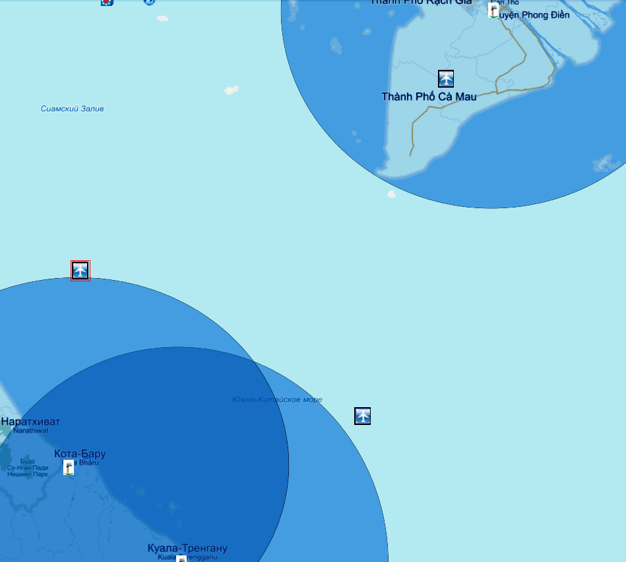
Real MAS318 (MH370 analog) flight 23.03.14, 18:15 UTC, tracking as it is
Tho
MAS318
TGW2657
TGW2907
Bharu
Terengganu
No
Surveillance under SSR & ADS-B, tracking in ATC
Surveillance under SSR & ADS-B, tracking in ATC
No surveillance, no tracking
17:15
17:35
17:55
18:15
UTC

Slide 35
Real MAS318 (MH370 analog) flight 23.03.14, 18:20 UTC, tracking as it is
MAS318
Tho
TGW2657
TGW2907
Bharu
Terengganu
No
Surveillance under SSR & ADS-B, tracking in ATC
Surveillance under SSR & ADS-B, tracking in ATC
No surveillance, no tracking
17:15
17:35
17:55
18:15
UTC

Slide 36
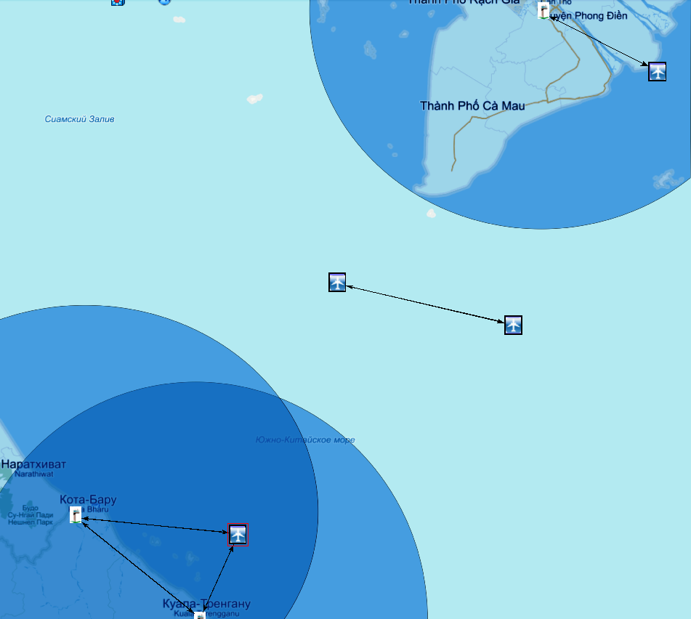
Real MAS318 (MH370 analog) flight 23.03.14, 17:15 UTC,
with hypothetic SOAN connected with ATC
Tho
TGW2907
MAS6116
CES539
MAS318
Bharu
Terengganu
Storing data within SOAN
Surveillance under SSR & ADS-B, tracking in ATC
With ATC,
surveillance
& tracking
in ATC
Surveillance under SSR & ADS-B, tracking in ATC
Without
ATC, no
surveillance
Without
ATC, no
surveillance
17:15
17:35
17:55
UTC
18:15

Slide 37
Real MAS318 (MH370 analog) flight 23.03.14, 17:20 UTC,
with hypothetic SOAN connected with ATC
Tho
TGW2907
MAS6116
CES539
MAS318
Bharu
Terengganu
Storing data within SOAN
Surveillance under SSR & ADS-B, tracking in ATC
With ATC
surveillance
& tracking
in ATC
Surveillance under SSR & ADS-B, tracking in ATC
Without
ATC, no
surveillance
Without
ATC, no
surveillance
17:15
17:35
17:55
UTC
18:15

Slide 38
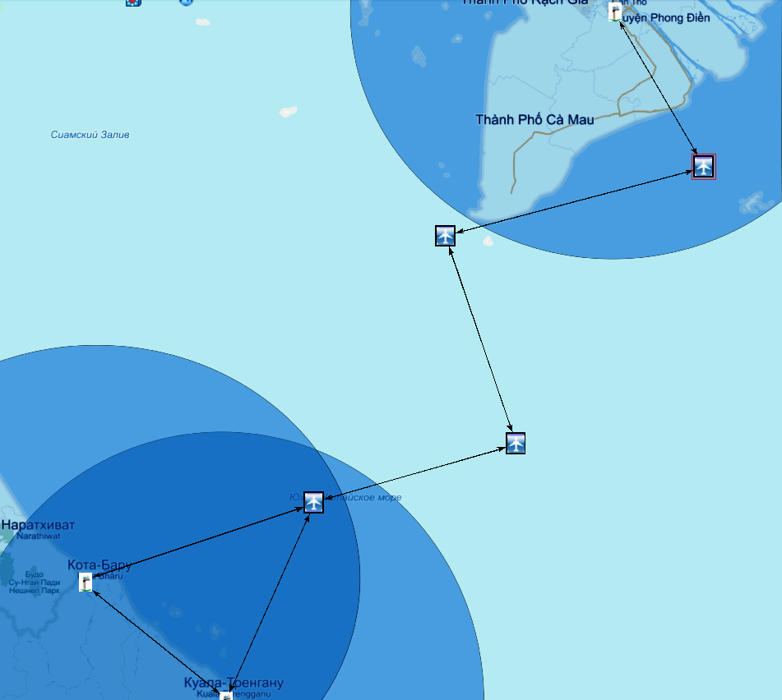
Real MAS318 (MH370 analog) flight 23.03.14, 17:25 UTC,
with hypothetic SOAN connected with ATC
Tho
TGW2907
MAS6116
CES539
MAS318
Bharu
Terengganu
Storing data within SOAN
,
With ATC,
surveillance
& tracking
in ATC
Surveillance under SSR & ADS-B, tracking in ATC
Surveillance under SSR & ADS-B, tracking in ATC
Without
ATC, no
surveillance
Without
ATC, no
surveillance
17:15
17:35
17:55
UTC
18:15

Slide 39
Real MAS318 (MH370 analog) flight 23.03.14, 17:30 UTC,
storing data on both aircraft
Tho
MAS6116
TGW2907
MAS318
CES539
Bharu
Terengganu
Storing data within SOAN
Surveillance under SSR & ADS-B, tracking in ATC
With ATC,
surveillance
& tracking
in ATC
Surveillance under SSR & ADS-B, tracking in ATC
Without
ATC, no
surveillance
Without
ATC, no
surveillance
17:15
17:35
17:55
UTC
18:15

Slide 40
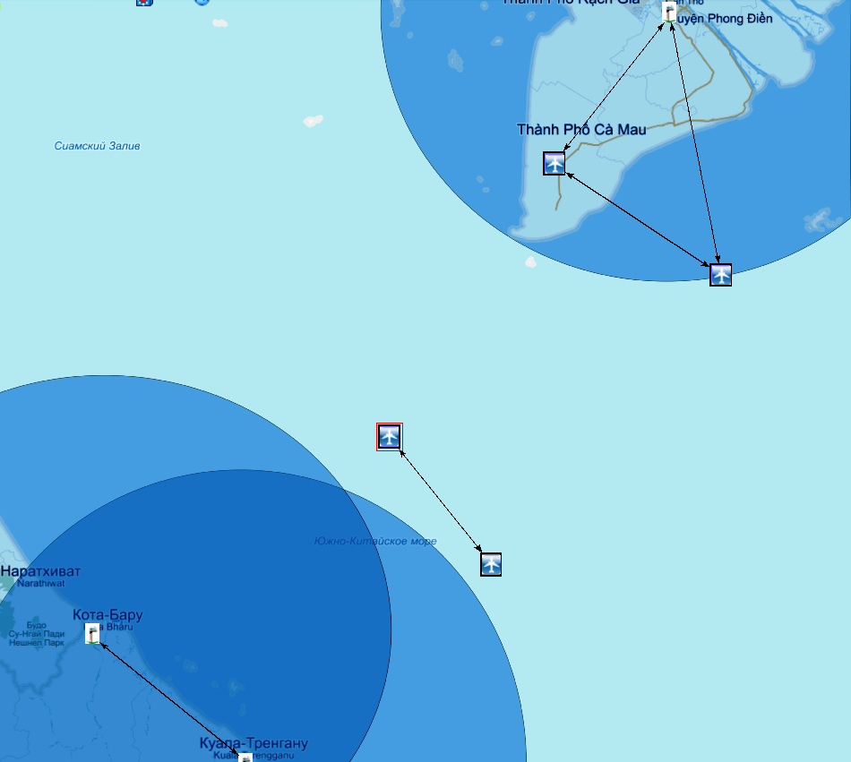
Real MAS318 (MH370 analog) flight 23.03.14, 17:35 UTC,
storing data on both aircraft
Tho
MAS6116
TGW2907
MAS318
CES539
Bharu
Terengganu
Storing data within SOAN
Surveillance under SSR & ADS-B, tracking in ATC
With ATC,
surveillance
& tracking
in ATC
Surveillance under SSR & ADS-B, tracking in ATC
Without
ATC, no
surveillance
Without
ATC, no
surveillance
17:15
17:35
17:55
UTC
18:15

Slide 41
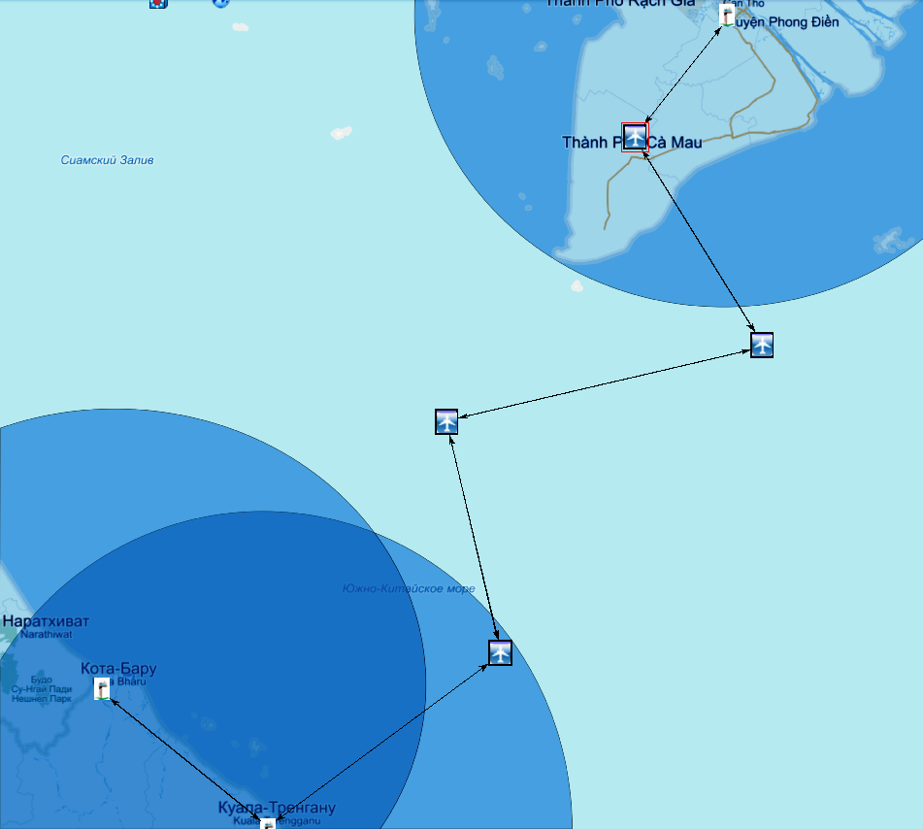
Real MAS318 (MH370 analog) flight 23.03.14, 17:40 UTC,
with hypothetic SOAN connected with ATC
Tho
MAS6116
MAS318
TGW2907
CES539
Bharu
Terengganu
Storing data within SOAN
Surveillance under SSR & ADS-B, tracking in ATC
With ATC,
surveillance
& tracking
in ATC
Surveillance under SSR & ADS-B, tracking in ATC
Without
ATC, no
surveillance
Without
ATC, no
surveillance
17:15
17:35
17:55
UTC
18:15

Slide 42
Real MAS318 (MH370 analog) flight 23.03.14, 17:45 UTC,
with hypothetic SOAN connected with ATC
Tho
MAS6116
MAS318
TGW2907
CES539
Bharu
Terengganu
Storing data within SOAN
Surveillance under SSR & ADS-B, tracking in ATC
With ATC,
surveillance
& tracking
in ATC
Surveillance under SSR & ADS-B, tracking in ATC
Without
ATC, no
surveillance
Without
ATC, no
surveillance
17:15
17:35
17:55
UTC
18:15

Slide 43
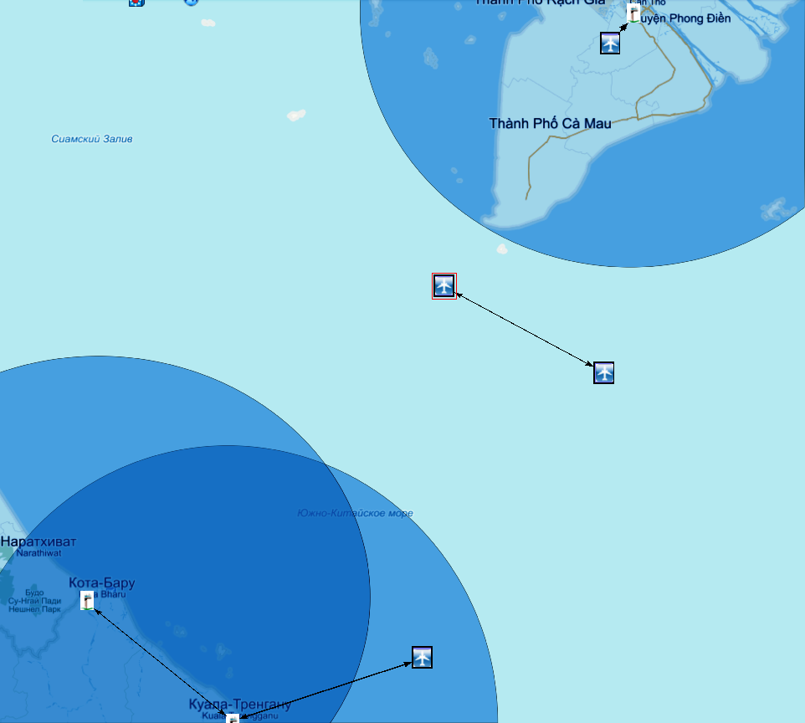
Real MAS318 (MH370 analog) flight 23.03.14, 17:50 UTC,
storing data on both aircraft
MAS6116
Tho
MAS318
TGW2907
CES539
Bharu
Terengganu
Storing data within SOAN
Surveillance under SSR & ADS-B, tracking in ATC
With ATC,
surveillance
& tracking
in ATC
Surveillance under SSR & ADS-B, tracking in ATC
Without
ATC, no
surveillance
Without
ATC, no
surveillance
17:15
17:35
17:55
UTC
18:15

Slide 44
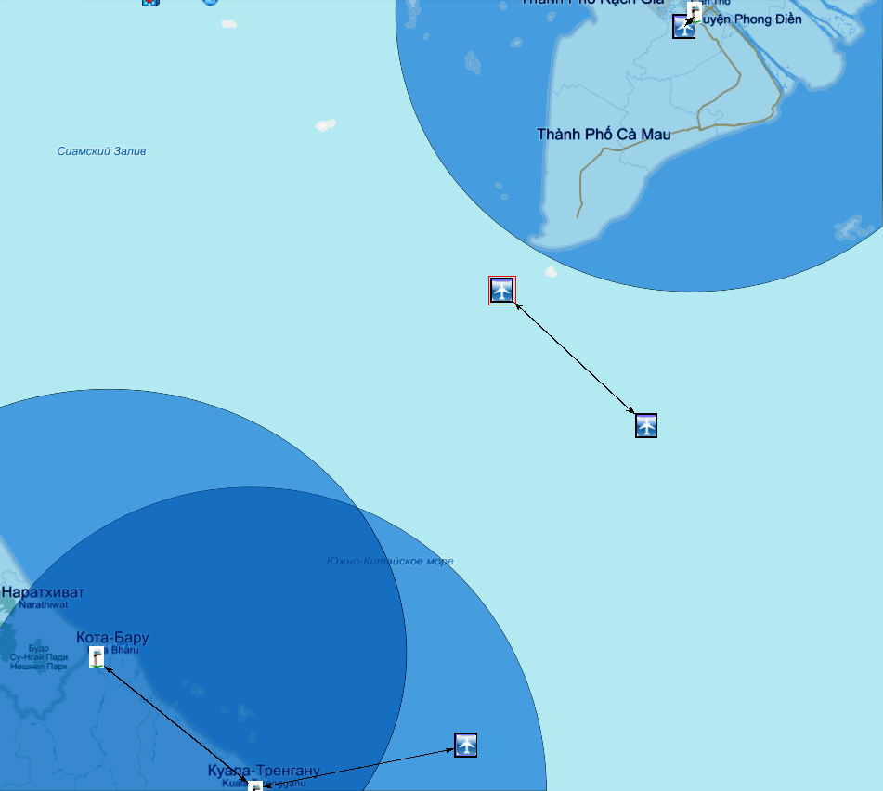
Real MAS318 (MH370 analog) flight 23.03.14, 17:55 UTC,
storing data on both aircraft
MAS6116
Tho
MAS318
TGW2907
Bharu
CES539
Terengganu
Storing data within SOAN
Surveillance under SSR & ADS-B, tracking in ATC
With ATC,
surveillance
& tracking
in ATC
Surveillance under SSR & ADS-B,
tracking in ATC
Without
ATC, no
surveillance
Without
ATC, no
surveillance
17:15
17:35
17:55
UTC
18:15

Slide 45
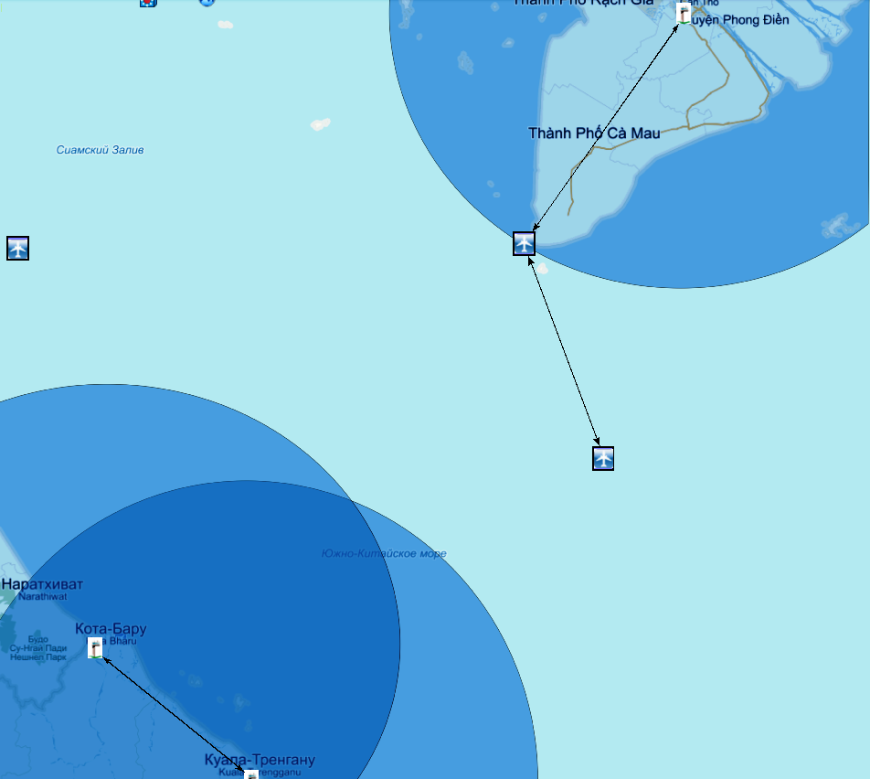
Real MAS318 (MH370 analog) flight 23.03.14, 18:00 UTC,
with hypothetic SOAN connected with ATC
Tho
TGW2657
MAS318
TGW2907
Bharu
Terengganu
Storing data within SOAN
Surveillance under SSR & ADS-B, tracking in ATC
With ATC,
surveillance
& tracking
in ATC
Surveillance under SSR & ADS-B, tracking in ATC
Without
ATC, no
surveillance
Without
ATC, no
surveillance
17:15
17:35
17:55
UTC
18:15

Slide 46
Real MAS318 (MH370 analog) flight 23.03.14, 18:05 UTC,
with hypothetic SOAN connected with ATC
Tho
MAS318
TGW2657
TGW2907
Bharu
Terengganu
Storing data within SOAN
Surveillance under SSR & ADS-B, tracking in ATC
With ATC,
surveillance
& tracking
in ATC
Surveillance under SSR & ADS-B, tracking in ATC
Without
ATC, no
surveillance
Without
ATC, no
surveillance
17:15
17:35
17:55
UTC
18:15

Slide 47
Real MAS318 (MH370 analog) flight 23.03.14, 18:10 UTC,
with hypothetic SOAN connected with ATC
Tho
MAS318
TGW2657
TGW2907
Bharu
Terengganu
Storing data within SOAN
Surveillance under SSR & ADS-B, tracking in ATC
With ATC,
surveillance
& tracking
in ATC
Surveillance under SSR & ADS-B, tracking in ATC
Without
ATC, no
surveillance
Without
ATC, no
surveillance
17:15
17:35
17:55
UTC
18:15

Slide 48
Real MAS318 (MH370 analog) flight 23.03.14, 18:15 UTC,
with hypothetic SOAN connected with ATC
Tho
MAS318
TGW2657
TGW2907
Bharu
Terengganu
Storing data within SOAN
Surveillance under SSR & ADS-B, tracking in ATC
With ATC,
surveillance
& tracking
in ATC
Surveillance under SSR & ADS-B, tracking in ATC
Without
ATC, no
surveillance
Without
ATC, no
surveillance
17:15
17:35
17:55
UTC
18:15

Slide 49
Real MAS318 (MH370 analog) flight 23.03.14, 18:20 UTC,
with hypothetic SOAN connected with ATC
MAS318
Tho
TGW2657
TGW2907
Bharu
Terengganu
Storing data within SOAN
Surveillance under SSR & ADS-B, tracking in ATC
With ATC,
surveillance
& tracking
in ATC
Surveillance under SSR ADS-B, tracking in ATC
Without
ATC, no
surveillance
Without
ATC, no
surveillance
17:15
17:35
17:55
UTC
18:15

Slide 50
Voice messages: cyber threats and protection.
Main types of attacks: noise, imitation
Threats | Amplitude modulation | Voice coder | Speech recognition if used
Communication deception | Carrier frequency shift. | Carrier frequency shift. Error correction coding. | Carrier frequency shift. Error correction coding. Original algorithm.
Interception. Forgery. | Scrambling | Encryption | Encryption
Spoofing | Carrier frequency shift | Encryption Authentication | Encryption Authentication
Rebroadcasting | Service information about time | Time stamping | Time stamping

Slide 51
Under cybersecurity point of view ADS-B was considered as an example. The main and the final conclusion
The taxonomy of attacks, methods and means of protection etc. were considered through ADS-B as an example.
In similar manner other aeronautical functions like ADS-C, TIS-B, FIS-B/SWIM, DGNSS, CPDLC, AOC, etc. concerning interaction of aircraft with ATC, other airspace users and not-friendly players must be reconsidered taking into account used data links and voice messages.
It looks that within the nearest years many or all existing ATC technologies will be reconsidered from the point of view of necessary and sufficient cybersecurity.
Mandatory encryption and use of airborne networks will promote cybersecurity issue in ATM

Slide 52
Thanks for attention!
Falkov@gosniias.ru

